Slide 1


GS for a “Killer” doing PRELIMS-CUM-MAINS Prep.
GSM1,2,3
GSM1,2,3
GSM1,3
GSM1, 2, 3
GSM1,2
Economy
Science Tech
Current
History
Geography
Polity
Agriculture
Environment
Culture
IR/Defense
GSM1
GSM 2,3
GSM 1, 2, 3
Notes:
Killing is as easy as breathing.

Slide 2
Environment MCQs
Theory / terms
National
Laws, schemes, policies
Pollution & Energy
Intl.
Org- “about us” Treaties,
conferences
Yearbook
Wildlife
Flora Fauna
parks, sanctuaries
Eco. Succession
Food chain/web….
Nuisance
Research

Slide 3
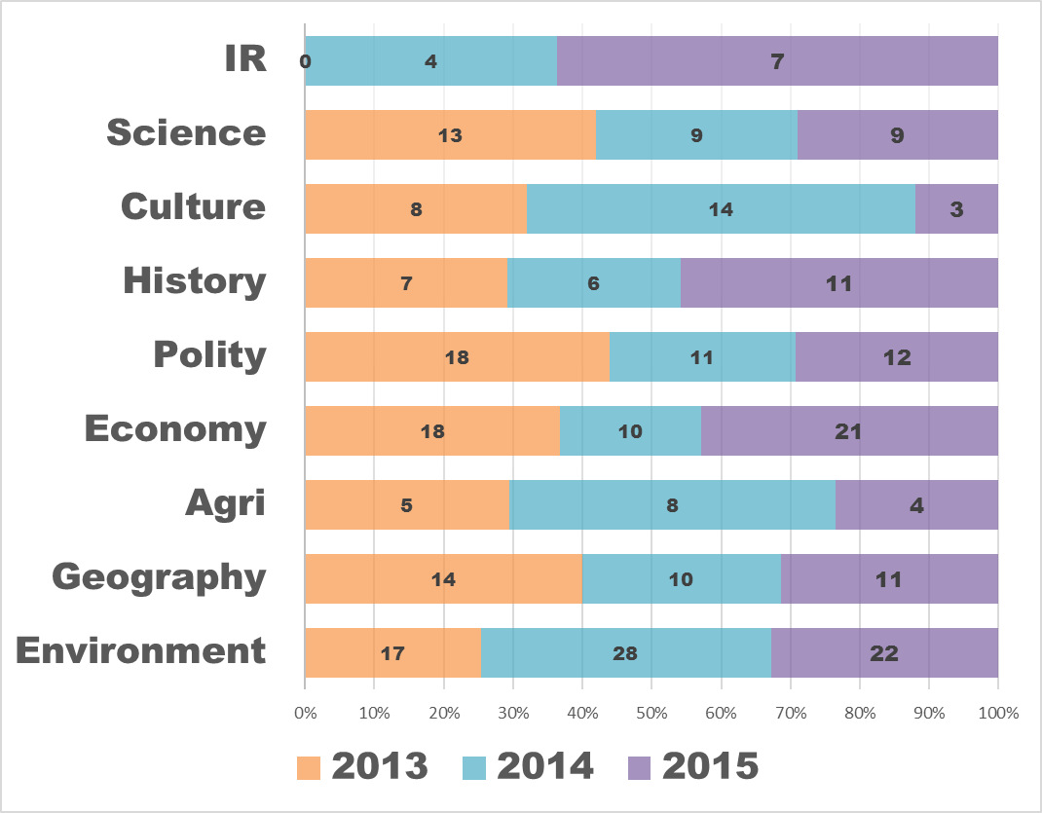
Brief analysis of last 3 Prelim papers
preCSAT: PIN
Sports, PIN Easy to moderate
Pinch higher than NCERT
Lunacy gone. 2/3 solvable.
Freedom struggle getting bit tougher
Medieval making comeback
No current. Mostly Laxmikanth
Easy to moderate
Crazy physical
Easy to moderate.
Nothing IFoS-exclusive
Mostly map based, Moderate
Easy to moderate.
Nothing IFoS-exclusive

Slide 4

"About us" of various organizations- Biocarbond fund, IREDA, birdlife watch. But cost benefit is rather low.
CSE-2015
'BioCarbon Fund Initiative for Sustainable Forest Landscapes' is managed by the __.
(a) Asian Development Bank
(b) International Monetary Fund
(c) United Nations Environment Programme
(d) World Bank
‘D’ As per Biocarbon fund's About us

Slide 5

"About us" of various organizations- Biocarbond fund, IREDA, birdlife watch. But cost benefit is rather low.
CSE-2015
50. Indian Renewable Energy Development Agency Limited (IREDA) ….
1. It is a Public Limited Government Company.
2. It is a Non - Banking Financial Company.
Select the correct statements
(a) 1 only
(b) 2 only
(c) Both 1 and 2
(d) Neither 1 or 2
As per IREDA's page About us both right

Slide 6
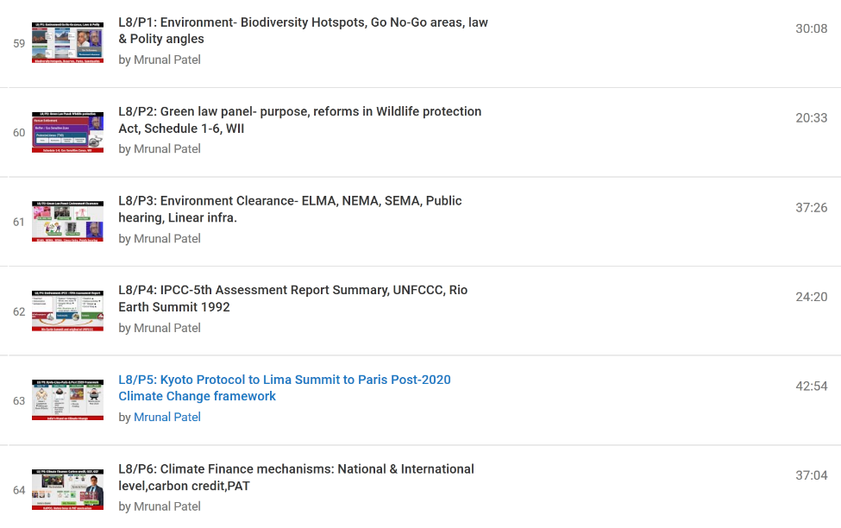
https://www.youtube.com/user/TheMrunalPatel
PRE- 2015
2TF on Green climate fund. (L8/P6)
Treaty on Ozone substances is Montreal (L8/P5)
Rio+20 associated with ____. (L8/P4)

Slide 7

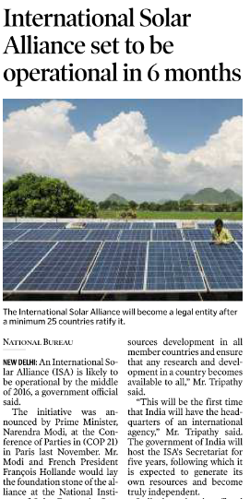

Hindu- January 2016, Week4
Countries with land between Capricorn and cancer
Having 300 days or more sunlight
Get $3 trill. By 2030
India to host Secretariat in Gurgaon for 5 years, already gave 100 crores.
India is not a road blocker but pioneer in fight against climate change
Notes:
What is India doing for climate change at intl. level?

Slide 8
Environment MCQs
Theory / terms
National
Laws, schemes, policies
Pollution & Energy
Intl.
Org- “about us” Treaties,
conferences
Yearbook
Wildlife
Flora Fauna
parks, sanctuaries
Eco. Succession
Food chain/web….
Nuisance
Research

Slide 9

Yearbook type
CSE-2015
13. The Genetic Engineering Appraisal Committee is constituted under the
Food Safety and Standards Act, 2006
Geographical Indications of Goods (Registration and Protection) Act, 1999
Environment (Protection) Act, 1986
Wildlife (Protection) Act, 1972

Slide 10
Why read India yearbook?
CSE-2015
13. The Genetic Engineering Appraisal Committee is constituted under the
Food Safety and Standards Act, 2006
Geographical Indications of Goods (Registration and Protection) Act, 1999
Environment (Protection) Act, 1986
Wildlife (Protection) Act, 1972
India 2015 yearbook page 303, Answer is "C"

Slide 11
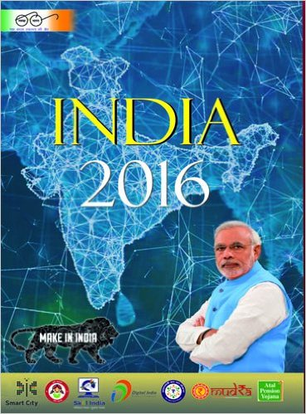
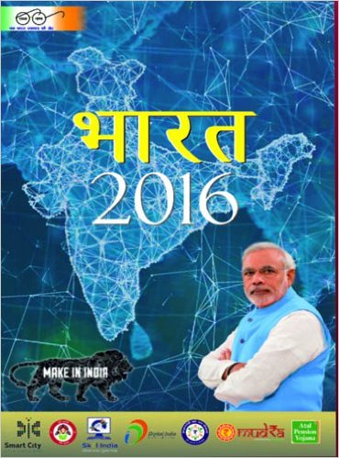

What exactly is “yearbook”?
Sarkaari book
Published each year
…
Must for UPSC

Slide 12
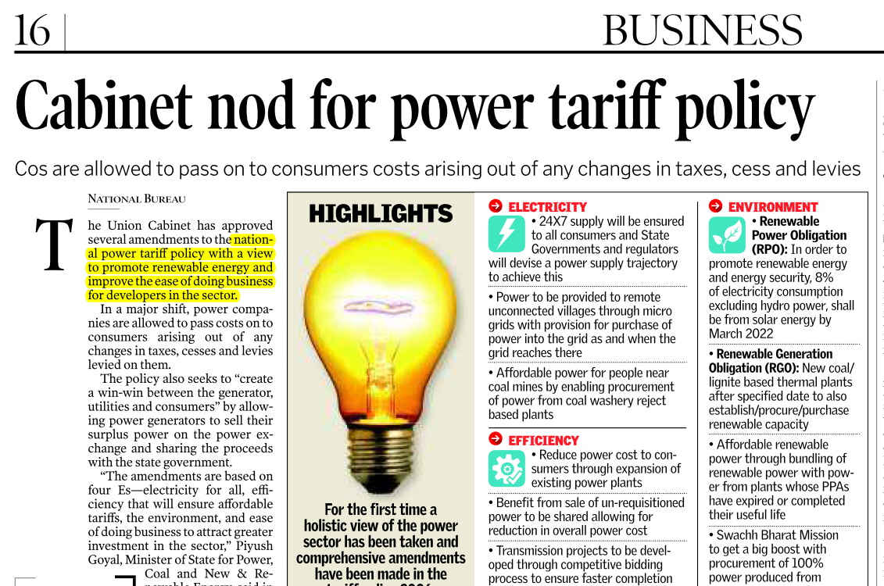

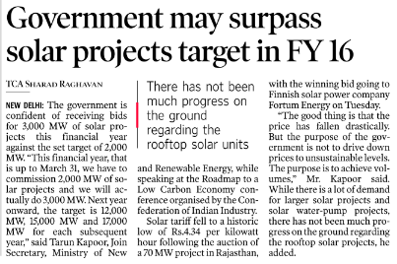
Eco. Survey will cover.
Ball by ball not imp.
Notes:
Survey maa fer thi.

Slide 13
Environment MCQs
Theory / terms
National
Laws, schemes, policies
Pollution & Energy
Intl.
Org- “about us” Treaties,
conferences
Yearbook
Wildlife
Flora Fauna
parks, sanctuaries
Eco. Succession
Food chain/web….
Nuisance
Research

Slide 14
Fauna
CSE-2015
69. With reference to 'dugong', a mammal found in India, which of the following statements is/an; correct?
1. It is a herbivorous marine animal.
2. It is found along the entire coast of India.
3. It is given legal protection under Schedule I of the Wildlife (Protection) Act, 1972.
Select: (a)1 and 2; (b)2 only; (c)1 and 3; (d)3 only
As per Hindu-2012; and ToI Jul-2015
Notes:
What is the natial ____ is the national aquatic animal.

Slide 15
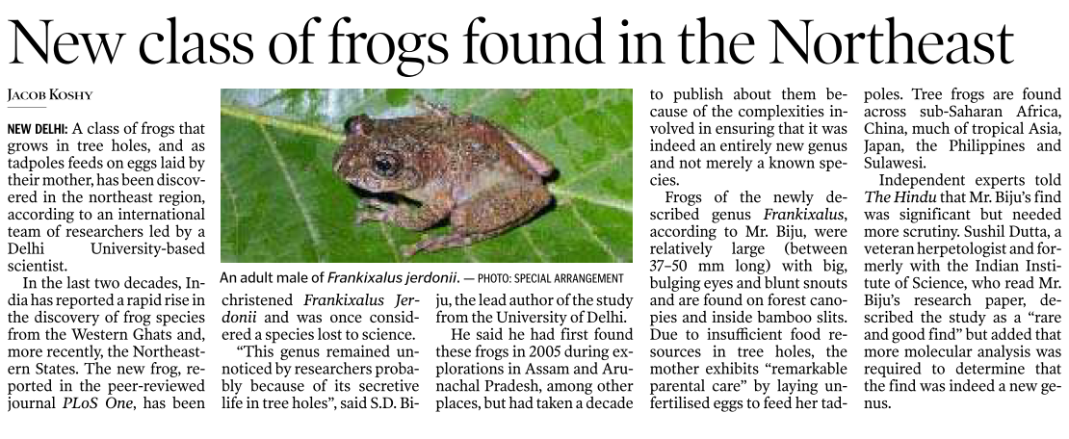
(almost) never seen “new species” related qs.

Slide 16
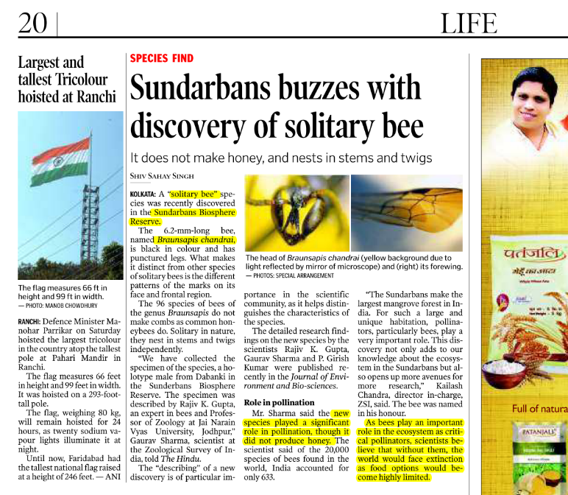
Guinness book type GK not imp for UPSC
Even smallest of lifeform is important
Notes:
Role of bees in pollination.

Slide 17
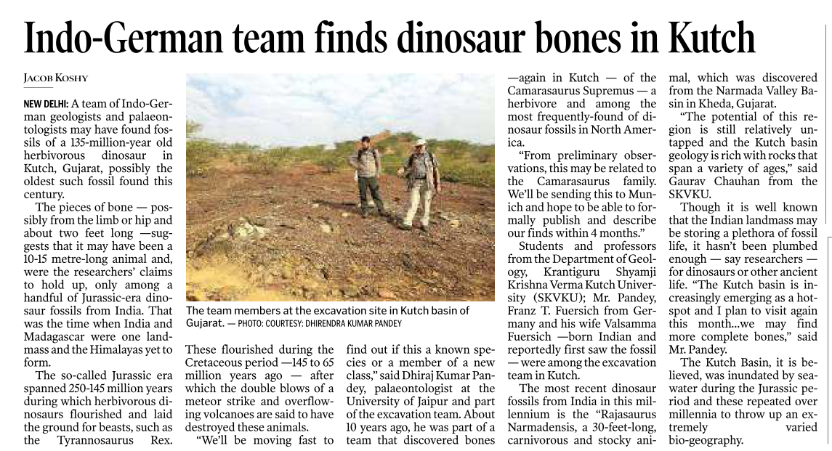
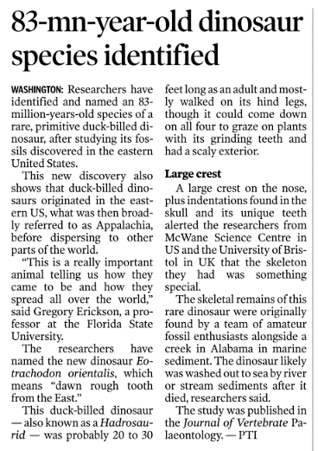
theHindu’s obsession with Dino discoveries
Never seen dino discovery MCQ in last 21 years.
Notes:
Hindu’s obsession with dinos is stupid.

Slide 18
Environment-Flora: WHY READ NCERT?
CSE-2015
28. teak is a dominant tree species in which of the following forests?
(a) Tropical moist deciduous forest
(b) Tropical rain forest
(c) Tropical thorn scrub forest
(d) Temperate forest with grasslands

Slide 19
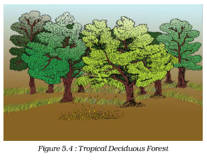
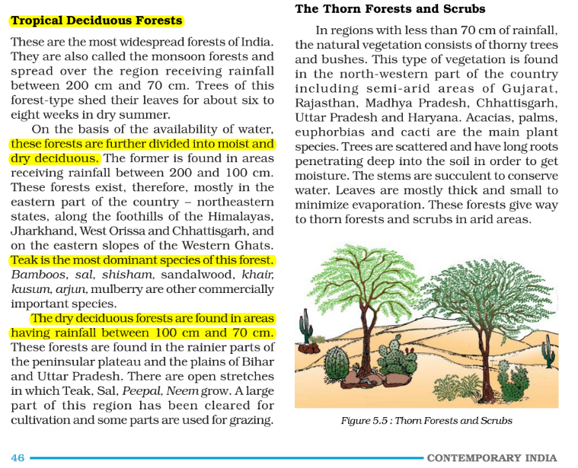
NCERT Class9 (Contemporary India) ch.5, Pg.46

Slide 20
Environment-Flora: WHY READ NCERT?
CSE-2015
28. In India, in which one of the following types of forests is teak a dominant tree species?
(a) Tropical moist deciduous forest
(b) Tropical rain forest
(c) Tropical thorn scrub forest
(d) Temperate forest with grasslands

Slide 21
Why map reading necessary?
CSE-2015
Teak is a dominant tree species in ____ forest.
____ national park has swamp with floating vegetation (4 options)
Tropical Wet Evergreen Forests occurs in ___ state(s) (3TF: Arun.P., Himachal, Mizoram)
Combination of mangrove forest, evergreen, deciduous forest is found in ____ region. (AP, Bengal, Saurashtra, A&N)

Slide 22
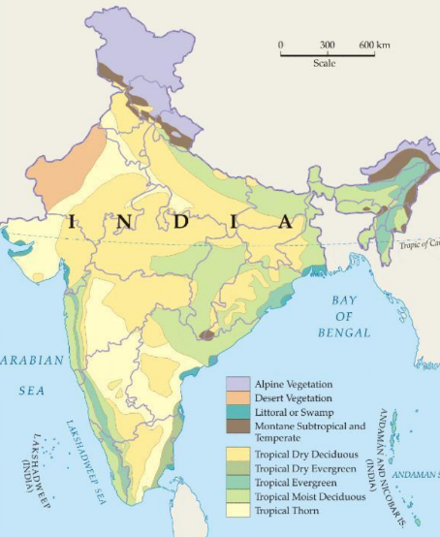
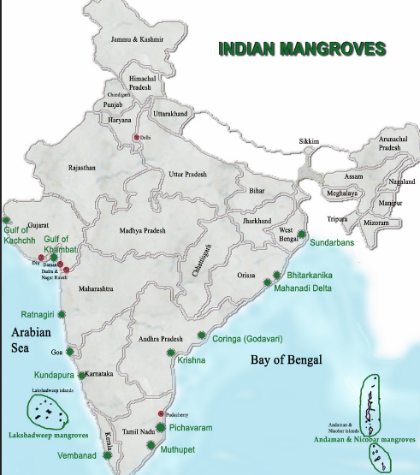
Why map reading necessary?

Slide 23
Environment MCQs
Theory / terms
National
Laws, schemes, policies
Pollution & Energy
Intl.
Org- “about us” Treaties,
conferences
Yearbook
Wildlife
Flora Fauna
parks, sanctuaries
Eco. Succession
Food chain/web….
Nuisance
Research

Slide 24
Climate, Pollution- soil, water, air
CSE-2015
Correct Statements about 'fly ash'
Fly ash can be used in the bricks making.
Fly ash can be used as a replacement for some of the Portland cement concrete.
Fly ash has silicon dioxide and calcium oxide only, and does not contain any toxic elements.
Choice (a) 1 and 2 (b) 2 only (c) 1 and 3 (d) 3 only

Slide 25
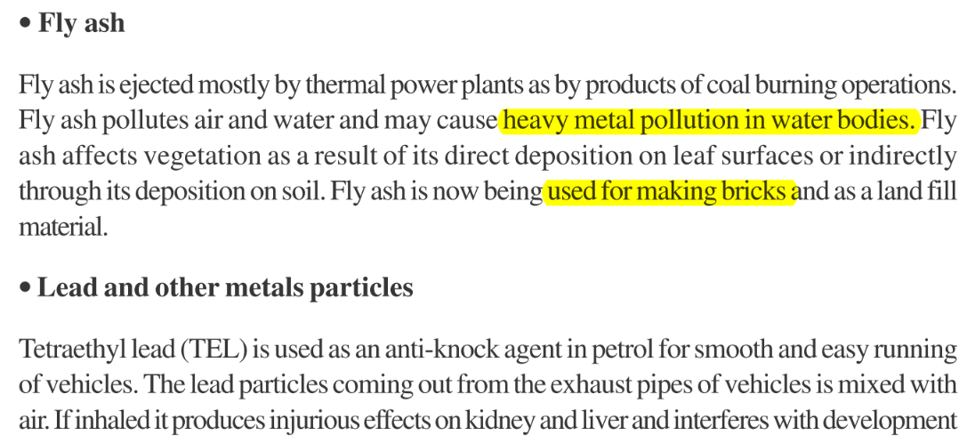
NIOS page 166

Slide 26
Why read NIOS?
CSE-2015
Correct Statements about 'fly ash'
1. Fly ash can be used in the production of bricks for building construction.
2. Fly ash can be used as a replacement for some of the Portland cement concrete.
3. Fly ash is made up of silicon dioxide and calcium oxide only, and does not contain any toxic elements.
Choice (a) 1 and 2 (b) 2 only (c) 1 and 3 (d) 3 only
Correct according to Hindu 2013

Slide 27
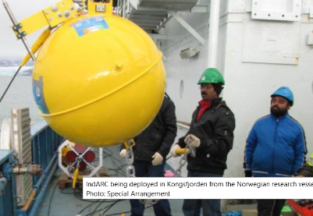
Inventions/ technology for climate / clean energy / pollution
CSE-2015
23. The term 'IndARC‘ is ___.
(a) an indigenously developed radar system inducted into Indian Defence
(b) India's satellite to provide services to the countries of Indian Ocean Rim
(c) a scientific establishment set up by India in Antarctic
(d) India’s underwater observatory to scientifically study the Arctic region
Hindu- 2014, Sept. http://www.thehindu.com/sci-tech/energy-and-environment/indias-arctic-observatory-to-aid-climate-change-studies/article6405727.ece

Slide 28
Inventions/ technology for climate / clean energy / pollution
CSE-2015
Correct Statements about bio-toilets in Railways:
The decomposition of human waste in the bio-toilets is initiated by a fungal inoculum.
Ammonia and water vapour are the only end products in this decomposition which are released into the atmosphere.
Both A and B correct.
Neither A nor B correct.

Slide 29
Why read TheHindu one year before exam: May 2014
CSE-2015
Under the bio-toilet concept of the DRDO, the bio-digester tank in every toilet is filled with inoculums containing four types of bacteria.
The water trap system in the toilet prevents air from getting into the tank, the human waste is processed by anaerobic bacteria in seven chambers in the tank and the methane gas is allowed to escape into the air.

Slide 30
Why read TheHindu one year before exam
CSE-2015
Correct statements about bio-toilets in Railways:
The decomposition of human waste in the bio-toilets is initiated by a fungal inoculum.
Ammonia and water vapour are the only end products in this decomposition which are released into the atmosphere.
Both A and B
Neither A nor B
Ans. “D”: http://www.thehindu.com/news/national/tamil-nadu/biotoilets-in-trains-by-2022/article6069104.ece May 2014 (later also appeared but specific. Info missing)

Slide 31
Inventions/ technology for climate / clean energy / pollution
CSE-2015
45. Statements about Fuel cell
If pure hydrogen is used as a fuel, the fuel cell emits heat and water as by-products.
It can be used for powering buildings and not for small devices like laptop computers.
Fuel cells produce Alternating Current (AC).
Which of the statements given above is / are correct?
(a) 1 only (b) 2 and 3 only (c) 1 and 3 only (d) 1, 2 and 3

Slide 32
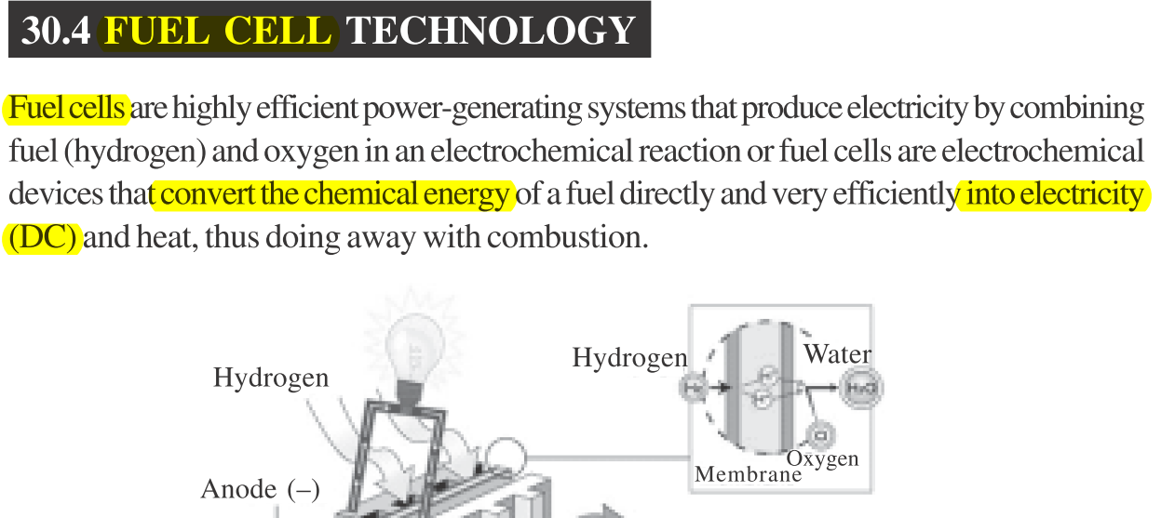
WHY READ NIOS Page 134

Slide 33
Inventions/ technology for climate / clean energy / pollution
CSE-2015
45. Statements about fuel cells:
1. If pure hydrogen is used as a fuel, the fuel cell emits heat and water as by-products.
2. can be used for powering buildings and not for small devices like laptop computers.
3. Fuel cells produce Alternating Current (AC).
Which of the statements given above is / are correct?
(a) 1 only (b) 2 and 3 only (c) 1 and 3 only (d) 1, 2 and 3
Can be used in laptop too. Hindu 2010

Slide 34
Environment
NIOS PDF (available under Mrunal.org/download)
NCERT (esp. class11 Env. chem)
Youtube: Mrunal
India yearbook 2016
theHindu span atleast 1 year before exam i.e. Jan 2015. (and if time permits- selective ToI, IE, DNA)
LucentGK | GS Manual (parks, sanctuaries etc.)
School Atlas

Slide 35
GS for a “Killer” doing PRELIMS-CUM-MAINS Prep.
GSM1,2,3
GSM1,2,3
GSM1,3
GSM1, 2, 3
GSM1,2
Economy
Science Tech
Current
History
Geography
Polity
Agriculture
Environment
Culture
IR/Defense
GSM1
GSM 2,3
GSM 1, 2, 3
Notes:
Killing is as easy as breathing.

Slide 36

Geography
Current|GK
Theory
Physical
Indian
Places in News
Match
World
Bank
IAS/IPS
SSC, CAPF, CDS, ACIO, APFC

Slide 37
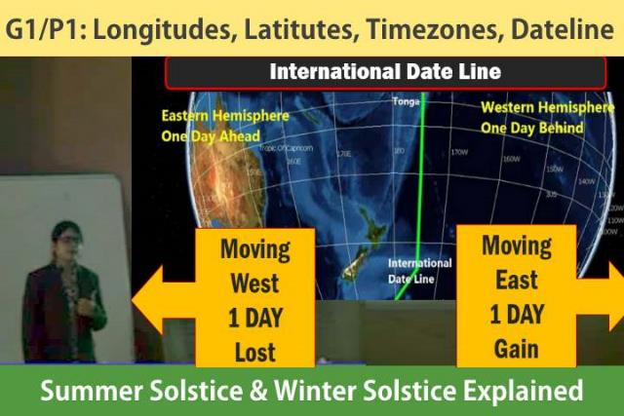

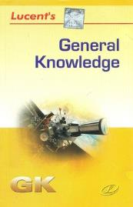

Current|GK
Theory
Places in News
Match
World
Physical
India
Geography lecture series by Ms. Rajtanil
New NCERTs
Bank
IAS/IPS
SSC, CAPF, CDS, ACIO, APFC
Goh Cheng leong IF time permits
Notes:
Majid and DR Khullar- too bad cost: benefit.

Slide 38
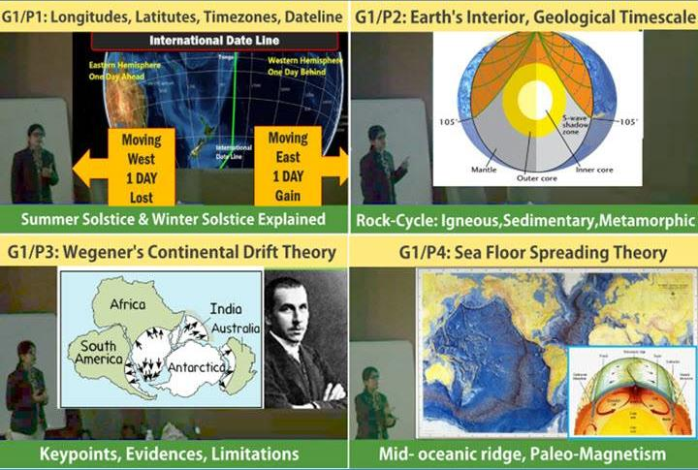
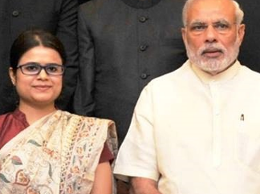
Rajtanil Solanki (Rank-367) IRS-Customs
Mrunal.org/Geography
Geography
For UPSC
https://www.youtube.com/user/TheMrunalPatel/playlists

Slide 39
Why read (new) NCERT?
CSE-2014
Which one of the following pairs of islands is separated from each other by the ‘Ten Degree Channel’?
Andaman and Nicobar
Nicobar and Sumatra
Maldives and Lakshadweep
Sumatra and Java
NCERT Class11 India Physical, page 19: “The Andaman in the north and the Nicobar in the south are separated by a water body called 10 degree channel”.

Slide 40
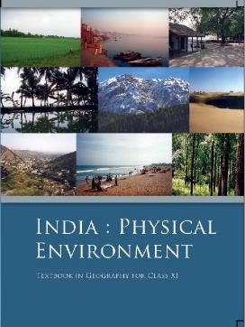
Physical World
Geography
Universe | Science Class 8 Ch.17 Geography Class 6 Ch.1 Geography Class 11 Ch 2.
Earth Basics | Geography Class 6 Ch.2 to 6 Geography Class 11 Ch.1, 3 & 4
Geology | Geography Class 11 Ch.5 to 7
climate | Geography Class 11 Ch.8 to 12
Ocean | Geography Class 11 Ch.13 & 14
Disaster | Geography Class 11 (Indian Geography) Ch.7 Science Class7 ch8 Science Class 8 ch15
Misc. | Geography Class 11 Ch.1 & glossary
After NCERT is done | Goh Che Leong’s Certificate Physical & Human Geography book General Studies Manual Spectrum
NCERT Class | World Geo.
7 | 7 to 10
8 | 1,3,5,6
12 (Human Geography) | 1 to 10

Slide 41
Indian Geography
Non-Bank
topic | class | chapters
India basic | 6 | 7
 | 9 | 1, 2, 4
 | 11 | 1 & 2
rivers | 9 | 3
 | 10 | 3
 | 11 | 3
 | 12 | 6
Economic geography | 10 | 1,5, 6, 7
 | 12 | 7 to 12
Human Geography | 9 | 6
 | 12 | 1 to 4
After NCERT is done- if giving CAPF,CDS, APFC | Spectrum Geography OR Lucent’s GK Book General Studies Manual

Slide 42
Why no need for (old) NCERT of Geography?
Geography
USSR gone; West and East Germany merged.
Coal-steel industrial location in UK and Germany have shifted. (Mrunal.org/geography)
Resource distribution neatly covered by Ms. Rajtanil Solanki’s lectures and PPT
In MCQs- there is nothing which can’t be solved without old NCERTs.

Slide 43

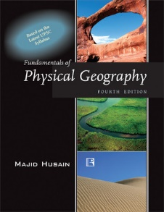
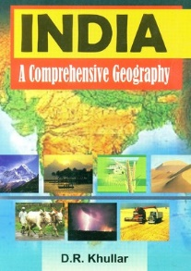
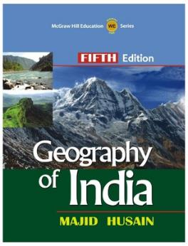
books
Physical
CDS/CAPF
India

Slide 44


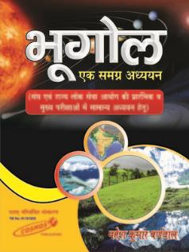
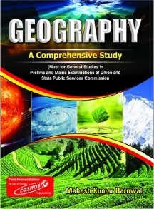
Geography (All in one)
Spectrum
UPSC: Prelim + Mains
Mahesh Barnwal
State Service

Slide 45
What type of MCQs are asked?
Geography
Physical: winds, tides, currents, cyclones,
This year mostly map/location based qs
description of an area- find climate/jungle type accordingly.
boundaries, places of significance-
match the following e.g. medieval state vs. present region, pilgrimage vs location
rivers- tributaries
world geography: Places in news- Golan heights; Boundaries- which of this nations don't open in Mediterranean Sea

Slide 46
Map skills necessary- even for INTERVIEW they ask.
CSE-2015
27. Which of this countries does not open out to the Mediterranean Sea?
(a) Syria
(b) Jordan
(c) Lebanon
(d) lsrael

Slide 47
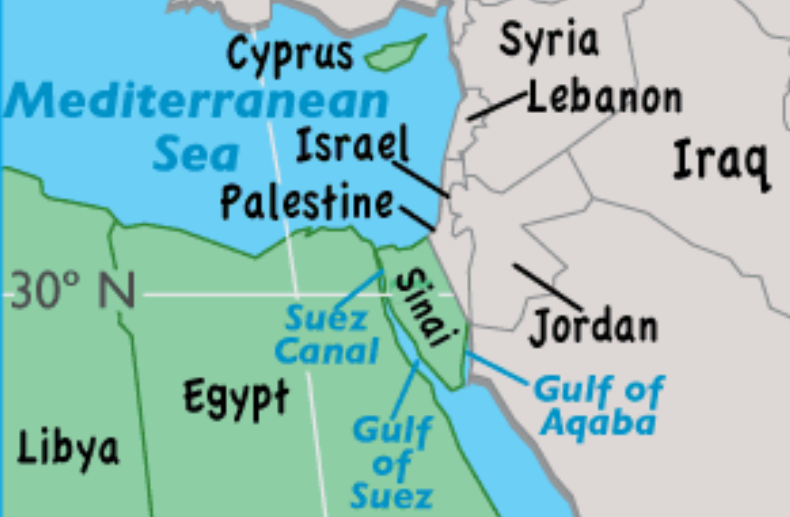
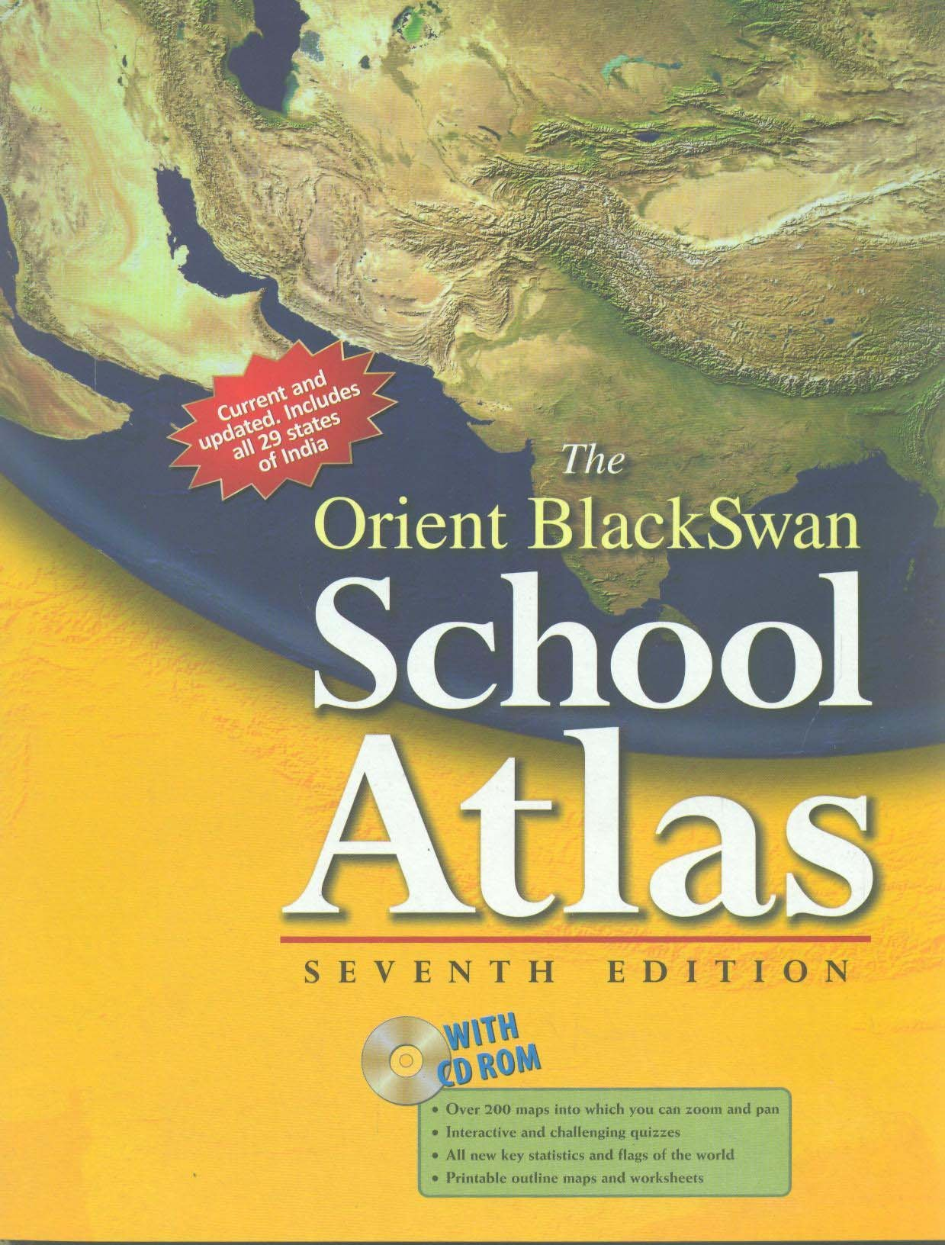
why refer to school atlas?
Don’t rely on google maps alone.
If you use school atlas- then you’ll also discover the places you’re not “actively SEARCHING”

Slide 48

Map skills necessary- even for INTERVIEW they ask.
CSE-2015
27. Which of this does not open out to the Mediterranean Sea?
(a) Syria
(b) Jordan
(c) Lebanon
(d) lsrael
Don’t rely on google maps alone.
Use school atlas- then you’ll also discover the places you’re not “actively SEARCHING”

Slide 49
Tribe location and occupation
2013
2014
Find correct pairs
Limboo (Limbu) : Sikkim
Karbi : Himachal Pradesh
Dongaria : Odisha
Bonda : Tamil Nadu
‘Changpa’ community of India, consider the following statement:
They live mainly in the State of Uttarakhand.
They rear the Pashmina goats that yield a fine wool.
They are kept in the category of Scheduled Tribes.
Nothing in 2015 prelims,
But still, read Andaman-Nicobar section in IYB-2016 Ch. 30

Slide 50
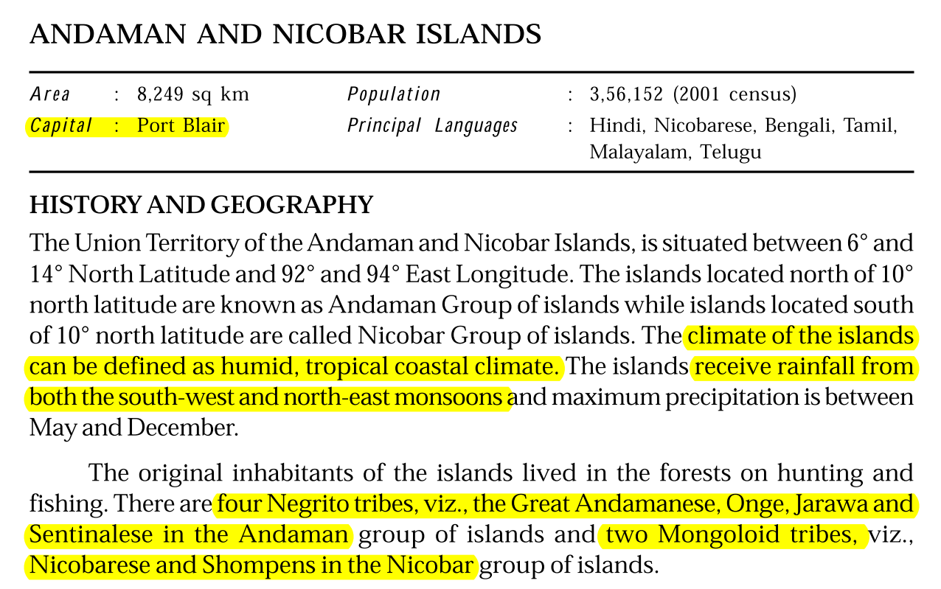
Geography in India Yearbook?
Ch 1- 3
20
30
At minimum

Slide 51
Geography, Environment, AGRICULTURE
preCSAT: PIN
Sports, PIN Easy to moderate
Pinch higher than NCERT
Lunacy gone. 2/3 solvable.
Freedom struggle getting bit tougher
Medieval making comeback
No current. Mostly Laxmikanth
Easy to moderate
Crazy physical
Moderate, but Nothing IFoS-exclusive
Mostly map based, Moderate
Easy to moderate.
Nothing IFoS-exclusive

Slide 52
Agriculture
NCERT class | subject | chapters
7 | science | 3 & 9
8 | geography | 4
 | science | 1
9 | science | 15
11 | geography (India) | 6
12 | geography (Human) | 5
 | geography (India land & people) | 5
After NCERT | Economic Survey, TheHindu; Food processing industry (Mrunal.org/ECONOMY)

Slide 53
https://www.youtube.com/user/TheMrunalPatel

Slide 54
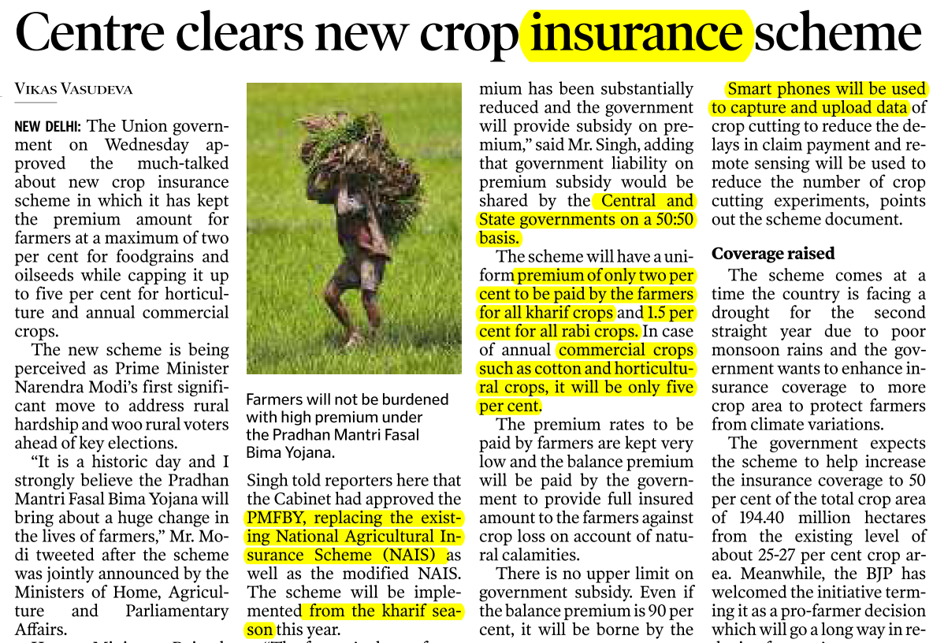


theHindu, Jan 2016

Slide 55
GS for a “Killer” doing PRELIMS-CUM-MAINS Prep.
GSM1,2,3
GSM1,2,3
GSM1,3
GSM1, 2, 3
GSM1,2
Economy
Science Tech
Current
History
Geography
Polity
Agriculture
Environment
Culture
IR/Defense
GSM1
GSM 2,3
GSM 1, 2, 3
Notes:
Killing is as easy as breathing.

Slide 56
Brief analysis of last 3 Prelim papers
preCSAT: PIN
Sports, PIN Easy to moderate
Pinch higher than NCERT
Lunacy gone. 2/3 solvable.
Freedom struggle getting bit tougher
Medieval making comeback
No current. Mostly Laxmikanth
Easy to moderate, mostly theory-contemporary
Crazy physical
Moderate to difficult but not IFoS-exclusive
Mostly map based, Moderate
Easy to moderate.
Nothing IFoS-exclusive
Notes:
Except jan dhan and 14th finance commission

Slide 57
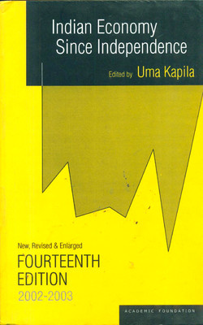
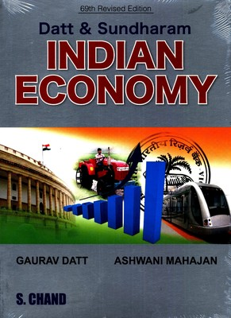
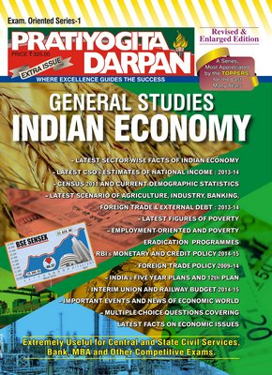
Not Essential for Economy
At max. just selected
Chapters on
Poverty, Development, Public-finance, Subsidies

Slide 58
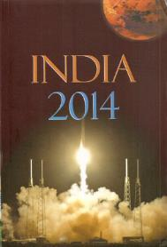
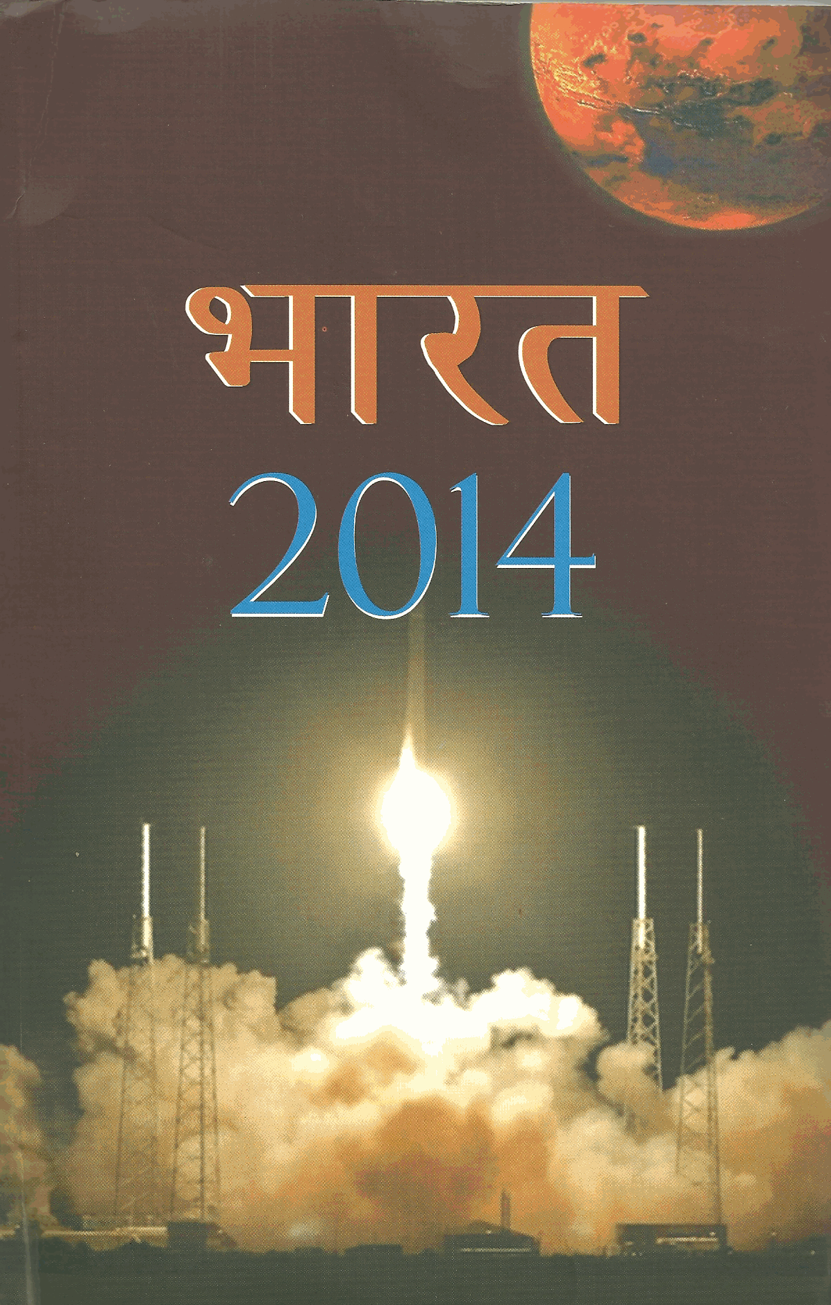
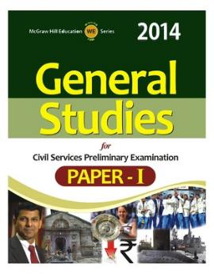

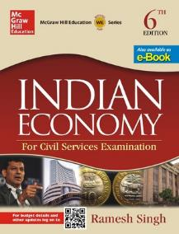
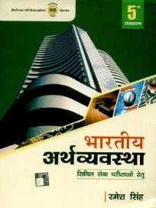
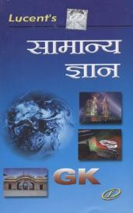

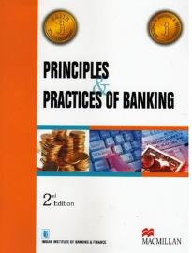
Economy: Dutt Sundaram, Uma Kapila
Wait for 2016
Land reform
Cooperatives
Ch.6,7,13,19;21-24
Selective MCQ
1,6,7
Others as per my lectures
Non-UPSC: unnecessary

Slide 59
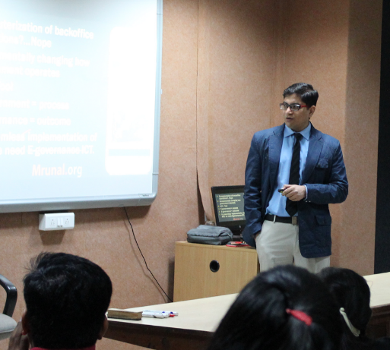
Then what to prepare?
NCERT 10,11, 12
IYB-2016
Lecture + Mrunal.org
Budget +Survey
TheHindu
13 out of 21 Questions in CSAT-2015
100 marks in Mains GS1,2,3 combined

Slide 60
GS for a “Killer” doing PRELIMS-CUM-MAINS Prep.
GSM1,2,3
GSM1,2,3
GSM1,3
GSM1, 2, 3
GSM1,2
Economy
Science Tech
Current
History
Geography
Polity
Agriculture
Environment
Culture
IR/Defense
GSM1
GSM 2,3
GSM 1, 2, 3
Notes:
Killing is as easy as breathing.

Slide 61
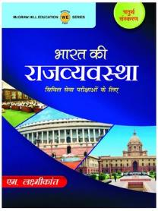
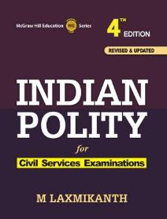



Polity
NCERT Pol.sci, sociology + India yearbook: ch.2, 3, 20, 28
Prsindia.org
Current
Theory
Committee
PIN
Appointment
Salient feature
Amendment
Quick reference:
GK type, Article #, const.Committees, oath, #seats etc.
Bank
SSC, UPSC [CSAT, CAPF, CDS, APFC], ACIO
Notes:
Banking-economy taxation related laws.

Slide 62
Brief analysis of last 3 Prelim papers
preCSAT: PIN
Sports, PIN Easy to moderate
Pinch higher than NCERT
Lunacy gone. 2/3 solvable.
Freedom struggle getting bit tougher
Medieval making comeback
No current. Mostly Laxmikanth
Easy to moderate
Crazy physical
Moderate to difficult but not IFoS-exclusive
Mostly map based, Moderate
Easy to moderate.
Nothing IFoS-exclusive

Slide 63
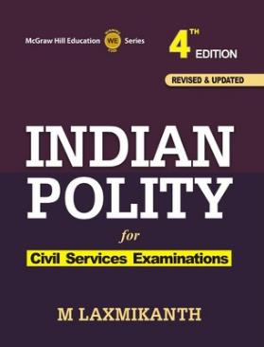

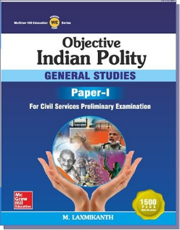
Polity preparation
Laxmikanth
History, Evolution
Union
States
Bodies
FR-FD, DPSP
PRI, ULB
MCQs
Along with spectrum freedom struggle
English edition
Hindi edition
BEGIN
from
HERE

Slide 64
Trend in 2015
Polity
Mains GS2: mostly Current SC judgements and bills.
Prelims: Entirely from theory
This time less 2TF/3TF Qs. usually about powers / provisions related statements.
Powers and Jurisdiction
Parliamentary procedures
meaning of terms: "custodian of constitution", "parliamentary system"

Slide 65
Meaning of terms
CSE-2015
11. Who /Which of the following is the custodian of the Constitution of India?
(a) The President of India
(b) The Prime Minister of India
(c) The Lok Sabha Secretariat
(d) The Supreme court of India
41. There is a Parliamentary System of Government in India because the
(a) Lok Sabha is elected directly by the people
(b) Parliament can amend the Constitution
(c) Rajya Sabha cannot be dissolved
(d) Council of Ministers is responsible to the Lok Sabha

Slide 66
Why read India Yearbook?
CSE-2015
94. Find Correct Statements
The Executive Power of the Union of India is vested in the Prime Minister.
The Prime Minister is the ex-officio Chairman of the Civil Services Board.
Both A and B correct
Neither A nor B correct

Slide 67
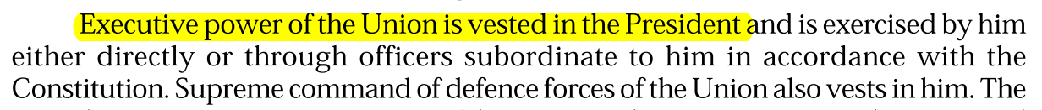
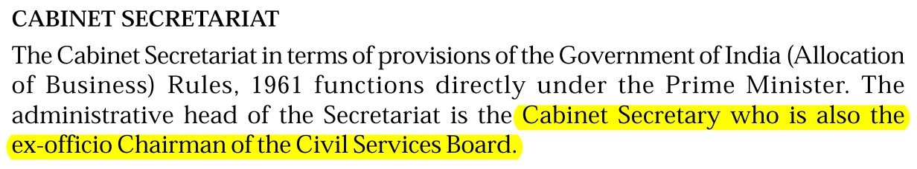
Why read India Yearbook chapter.3 Polity
Given in laxmikanth
Not given in Laxmikanth, but given in India Yearbook

Slide 68
Why read India Yearbook?
CSE-2015
94. Find Correct Statements
The Executive Power of the Union of India is vested in the Prime Minister.
The Prime Minister is the ex-officio Chairman of the Civil Services Board.
Both A and B correct
Neither A nor B correct

Slide 69
Exam in Dec. 2015
Mains-GS2
What are the major changes brought in the Arbitration and Conciliation Act, 1996 through the recent Ordinance promulgated by the President? How far will it improve India’s dispute resolution mechanism? Discuss. [Oct. 2015]

Slide 70
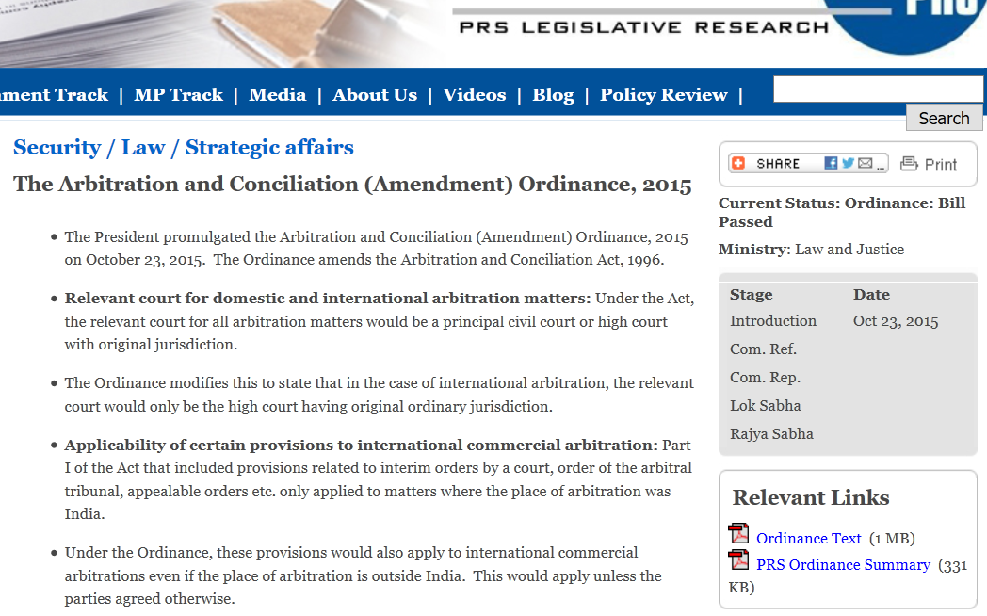
Why read PRSIndia.org?

Slide 71


Crime / politics / controversy?

Slide 72

Polity
Scholar suicide
Father OBC, mother SC.
Intercaste marriage: child to take father’s dominant caste.
but no strict application said SC (2012)- if suffered handicaps of mother.
Notes:
The court further noted that
a presumption in favour of ev-
ery child taking his father’s
dominant caste was almost im-
practical. On this point, the
court illustrated the case of a
pregnant tribal or Scheduled
Caste woman, abandoned by
her forward caste husband,
who would go back to her peo-
ple and community.

Slide 73


Read hindu but dig Laxmikanth for background

Slide 74


Small fodders make larger picture

Slide 75

GS2: Comparing Constitution

Slide 76
Polity
NCERT Pol.Sci and Sociology
Indian Polity – M.Laxmikanth
India Yearbook 2016
PRSIndia.org
TheHindu

